Slide 1
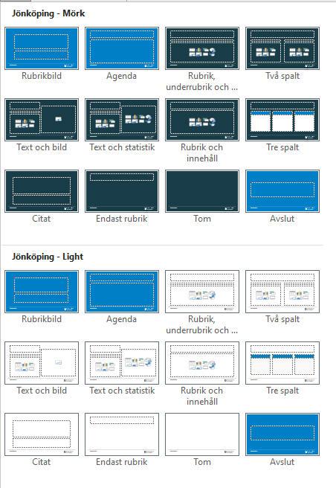
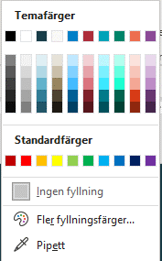
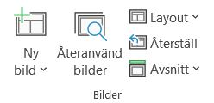
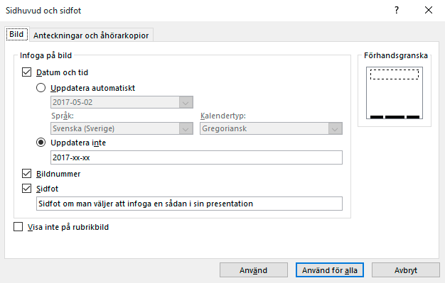
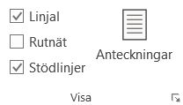
Instruktioner 1
Dold sida, visas inte vid utskrift
Mallsidor
Temafärger
Sidhuvud och sidfot
1. Ny bild, visar samtliga layoutsidor.
2. Layout, byter befintlig sidas utseende.
Befintliga layouter i mallen
Objekt färgsätts med de inringade färgerna som följer er grafiska profil.
Under fliken Infoga välj Sidhuvud och sidfot. Ändra i dialogen som du önskar och klicka på knappen Använd för alla för att använda på samtliga sidor med sidfot i presentationen eller Använd om du endast vill ändra i den sidan du står på.
Layouterna Rubrikbild, Agenda och Avslut ska endast användas för dessa ändamål. Det vill säga Rubrikbild som startbild, Agenda för agenda för presentationen och avslut som slutbild i presentationen.
3. Återställ, bilden visas i ursprungligt utseende. Används tex. för att få tillbaka punktlista om man tagit bort punkten.
Använd inte de inbyggda standardfärgerna.
Stödlinjer
Kontrollera att objekt och text är placerade innanför sidans marginaler. För att visa marginaler och stödlinjer, klicka på Visa och kryssa i rutan Stödlinjer (eller tryck Alt + F9).

Slide 2
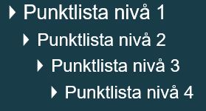
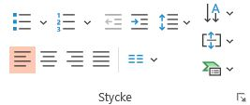
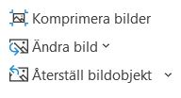
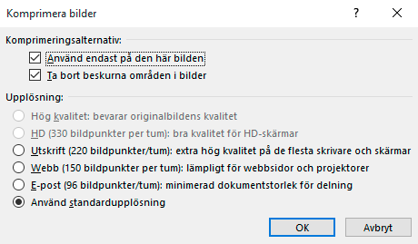

Instruktioner 2
Dold sida, visas inte vid utskrift
Punktlista och format
Bilder
De olika formatnivåerna som finns i mallen.
Använd inte dessa funktioner för att göra punktlista eller numrerad lista.
Om filen blir för tung och du vill minska storleken så välj en bild och klicka på Komprimera bilder.
Viktigt! komprimerade bilderna går inte att återställa. Bilderna måste läggas in
på nytt.
För att ändra nivån på format så klickar du på Öka/Minska indrag alt. Tab/Shift+Tab.
Om du önskar göra detta på alla bilder så klicka ur Använd endast på den här bilden.
Klipp och klistra
Bäst brukar vara att kopiera och klistra in enskilda objekt.
Tänk på att formatet från den gamla mallen/presentationen kan skilja sig åt och därför kommer det fungera olika. PowerPoint försöker alltid anpassa sig till den nya layouten men beroende på likheten mellan gamla och nya så fungerar det olika bra.
Använd alltid platshållare där det finns möjlighet.
Välj upplösning.

Slide 3
Welcome to the
Municipality of Jönköping!

Slide 4
Contents
Who we are in words and figures
Politics and organisation
Labour market and industry
A municipality focused on the future
The data and statistics have been obtained from the City Office Survey Unit and Statistics Sweden. Unless stated otherwise,
all the statistics are from 2024.
Notes:
Det här är vår övergripande kommun-presentation.
Den kan ses som ett stöd till dig som ska presentera kommunen - eller som en mall för att skapa en agenda.
Denna bild är inte nödvändig att ha med i själva presentationen.
SÅ HÄR ANVÄNDER DU PRESENTATIONEN:
Följ befintlig presentations struktur och upplägg.
Om du vill ta bort, dölja eller lägga till sidor går det bra – men ändra helst inte ordningen.
Om du vill lägga till fler kapitel/bilder finns det färdiga layouter att utgå från i de dolda bilderna på sida 3 och 4. Du hittar även fler layouter genom att infoga en ny sida vid pilen – under ”Ny bild” i menyn.
Om du vill infoga ett foto bakom balken (den blå sidfoten längst ner på varje sida), högerklicka på bilden och välj ”Formatera bakgrund”. Som fyllning väljer du ”Bild eller strukturfyllning” och sedan ”Infoga bild från fil”.
Lycka till med din presentation!

Slide 5
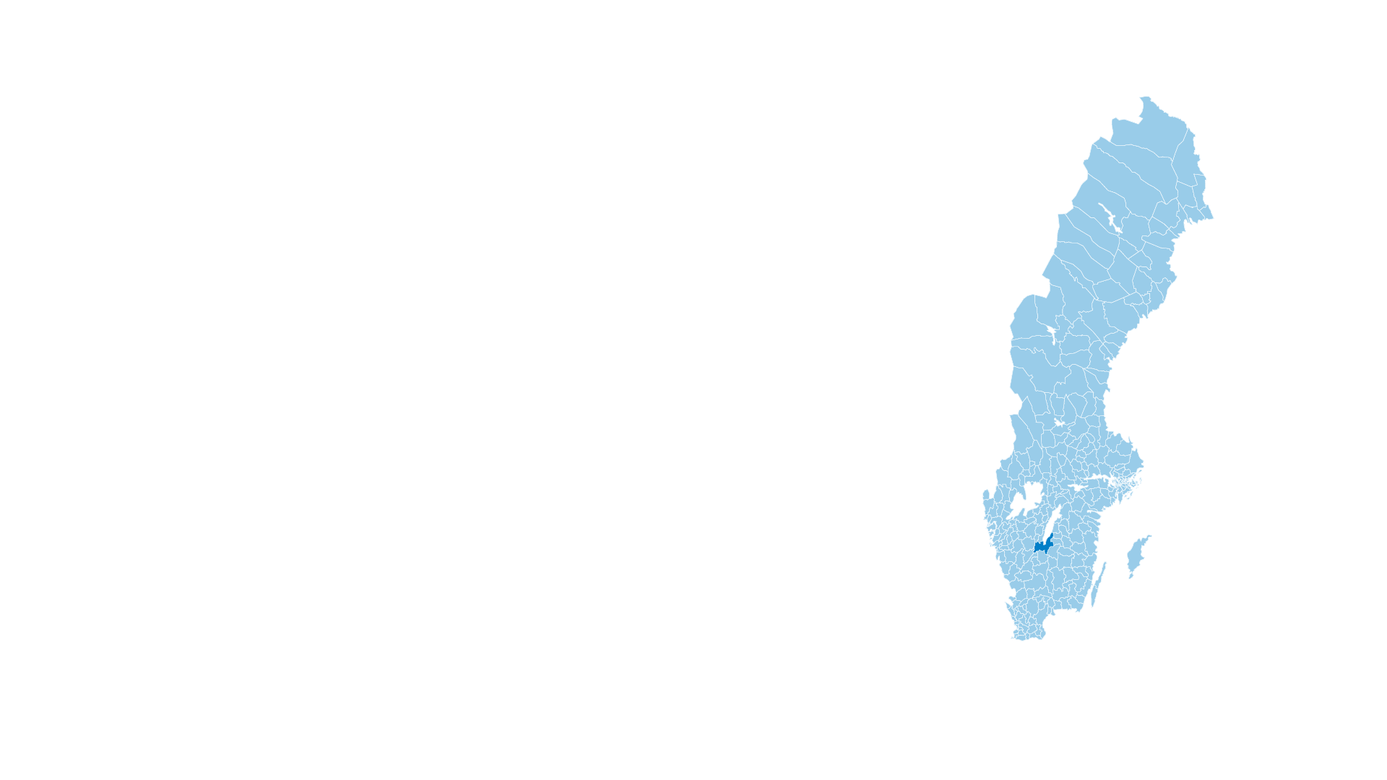
Good to know before we start
290 municipalities
Examples of responsibilities:
Schools, social services and eldercare
Municipalities are legally obliged to provide some services, while others are optional and decided
by local politicians.
Notes:
Municipalities are responsible for most of the social services available where we live. The most extensive services include schools, social services, and care for the elderly. Municipalities are legally obliged to provide some services, while others are optional and decided by local politicians.
The municipality has the right to make independent decisions and tax citizens to finance it’s activities.

Slide 6
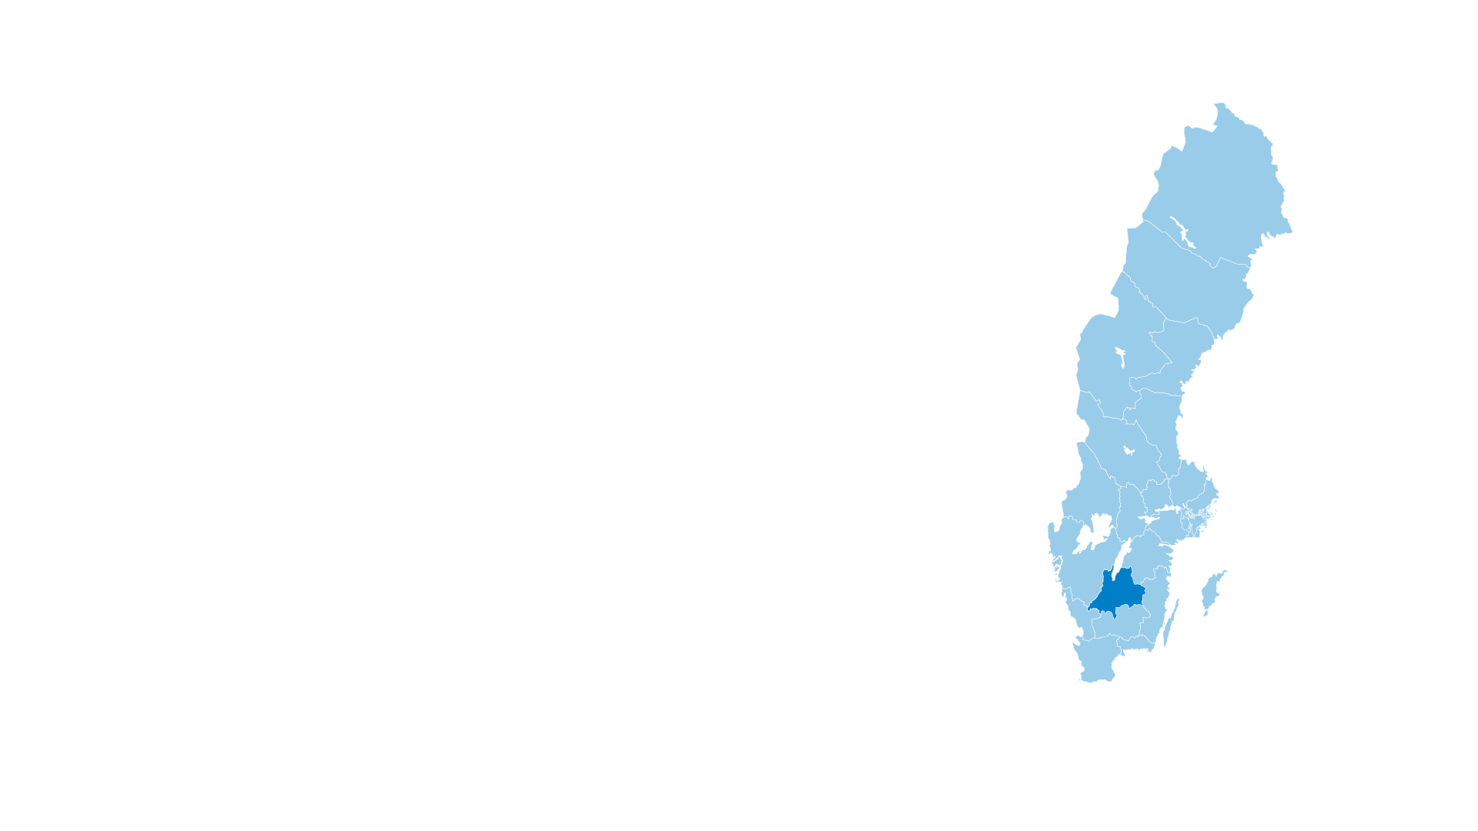
Good to know before we start
21 county councils/regions
Examples of responsibilities:
Healthcare, dental care and public transport
Regions are county councils with increased responsibility for regional development and infrastructure.
Notes:
County councils and regions are responsible for services shared over large geographical areas and which often demand considerable financial resources. These include healthcare, dental care, and public transport. Voluntary activities include culture, tourism, and regional development. Regions are county councils with an extended responsibility for regional development.
Politicians in the municipal and county council are elected directly by citizens. There are municipal and county council elections every four years in conjunction with the parliamentary election.

Slide 7
Who we are in words and figures
Notes:
The Municipality of Jönköping is around 1,500 square kilometres in size – almost twice the size of the city of New York. It is an area of contrasts, transitioning between rural communities, towns large and small, dense forest, rich agricultural land, lakes, and watercourses. The Municipality of Jönköping is at the interface between town and country.
Jönköping, which is the largest urban centre in the municipality, received its charter back in 1284. The municipality also includes the historic town of Gränna, founded in 1652, and Huskvarna, which dates back to the 17th century but did not officially become a town until 1911. Lake Vättern and the large island of Visingsö are also part of the Municipality of Jönköping.

Slide 8

Public service for
everyone in the municipality
Notes:
All residents of Jönköping municipality daily utilize the public services provided by the municipality.
Our mission is to ensure the availability of childcare, preschool, compulsory school, high school, and adapted school. We arrange municipal adult education, Swedish for immigrants (SFI), and social services.
We provide care for the elderly and for individuals with disabilities.
We are responsible for spatial planning and new constructions and ensure the availability of housing.
We ensure health and environmental protection, cleanliness, and proper waste disposal.
We have emergency services, handle crises during societal disruptions, and together with other actors, protect and defend society in times of war or threat of war.
We ensure the availability of water and sewage services and libraries.
We create opportunities for residents to engage in leisure activities and experience Jönköping municipality.

Slide 9
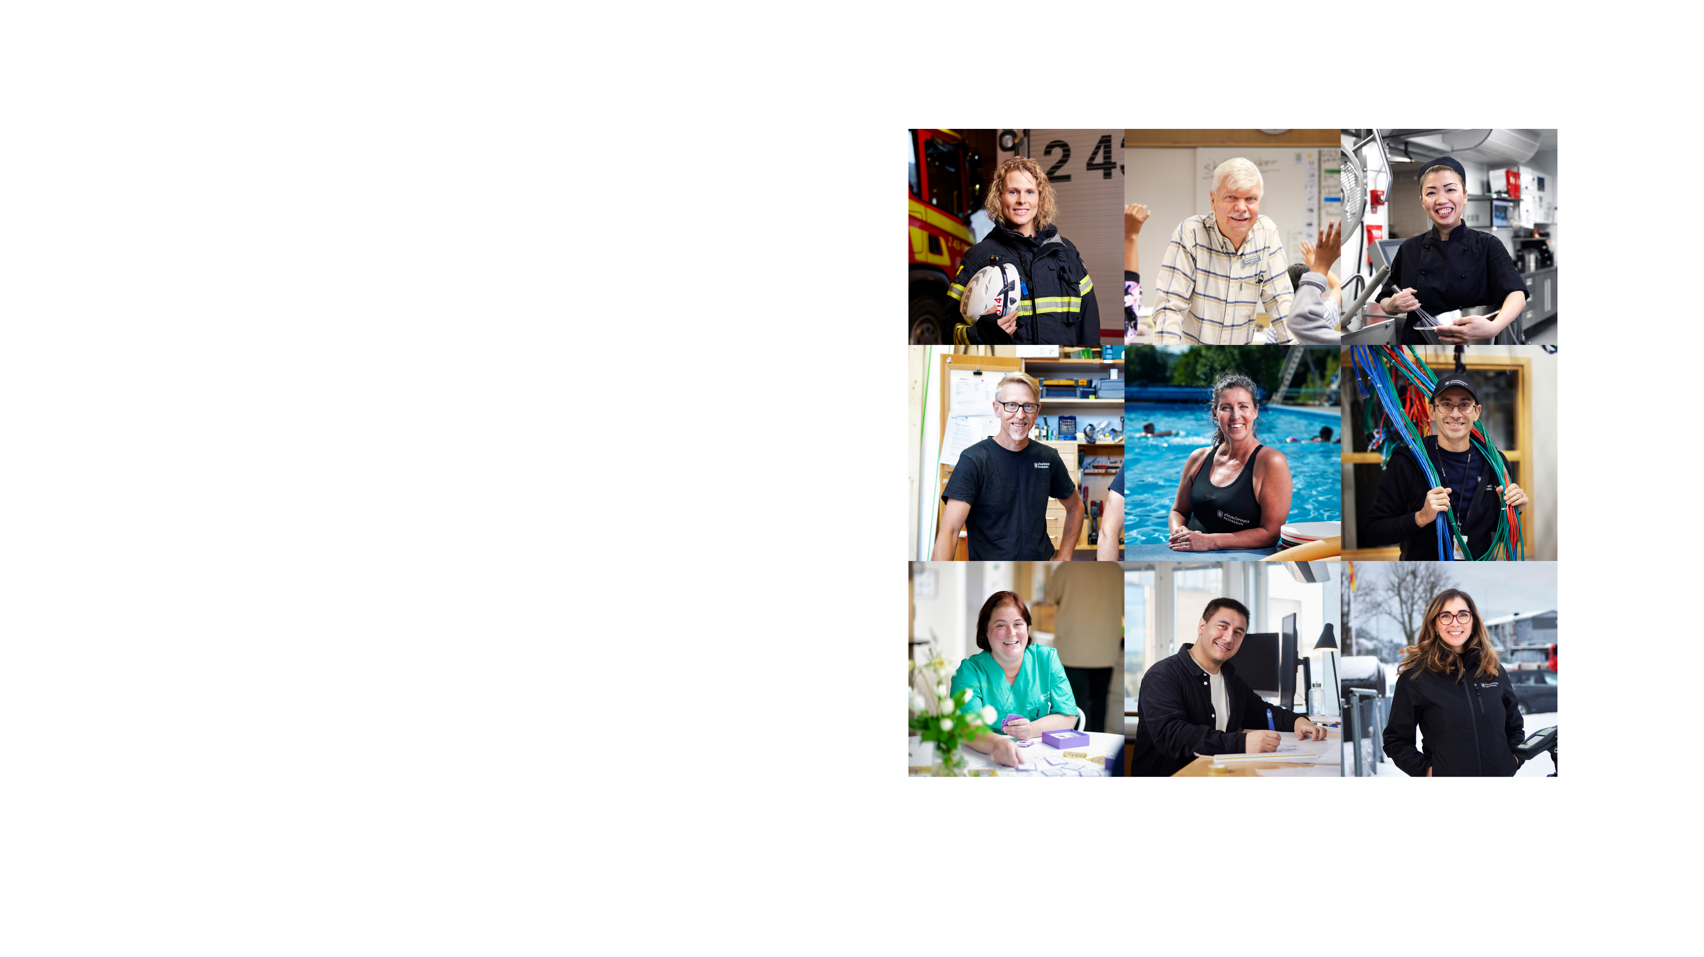
Together, we make Jönköping thrive
We take care of others and each other in everyday life. We are here, making a difference, changing, developing, and providing service.
We are more than 12,000 employees who together make Jönköping municipality thrive.
Notes:
Those of us working within Jönköping municipality, both elected officials and employees, share a common responsibility. Our collective mission is to ensure that all residents, visitors, and individuals living in our municipality have their rights fulfilled, receive excellent service, and are treated equitably.

Slide 10
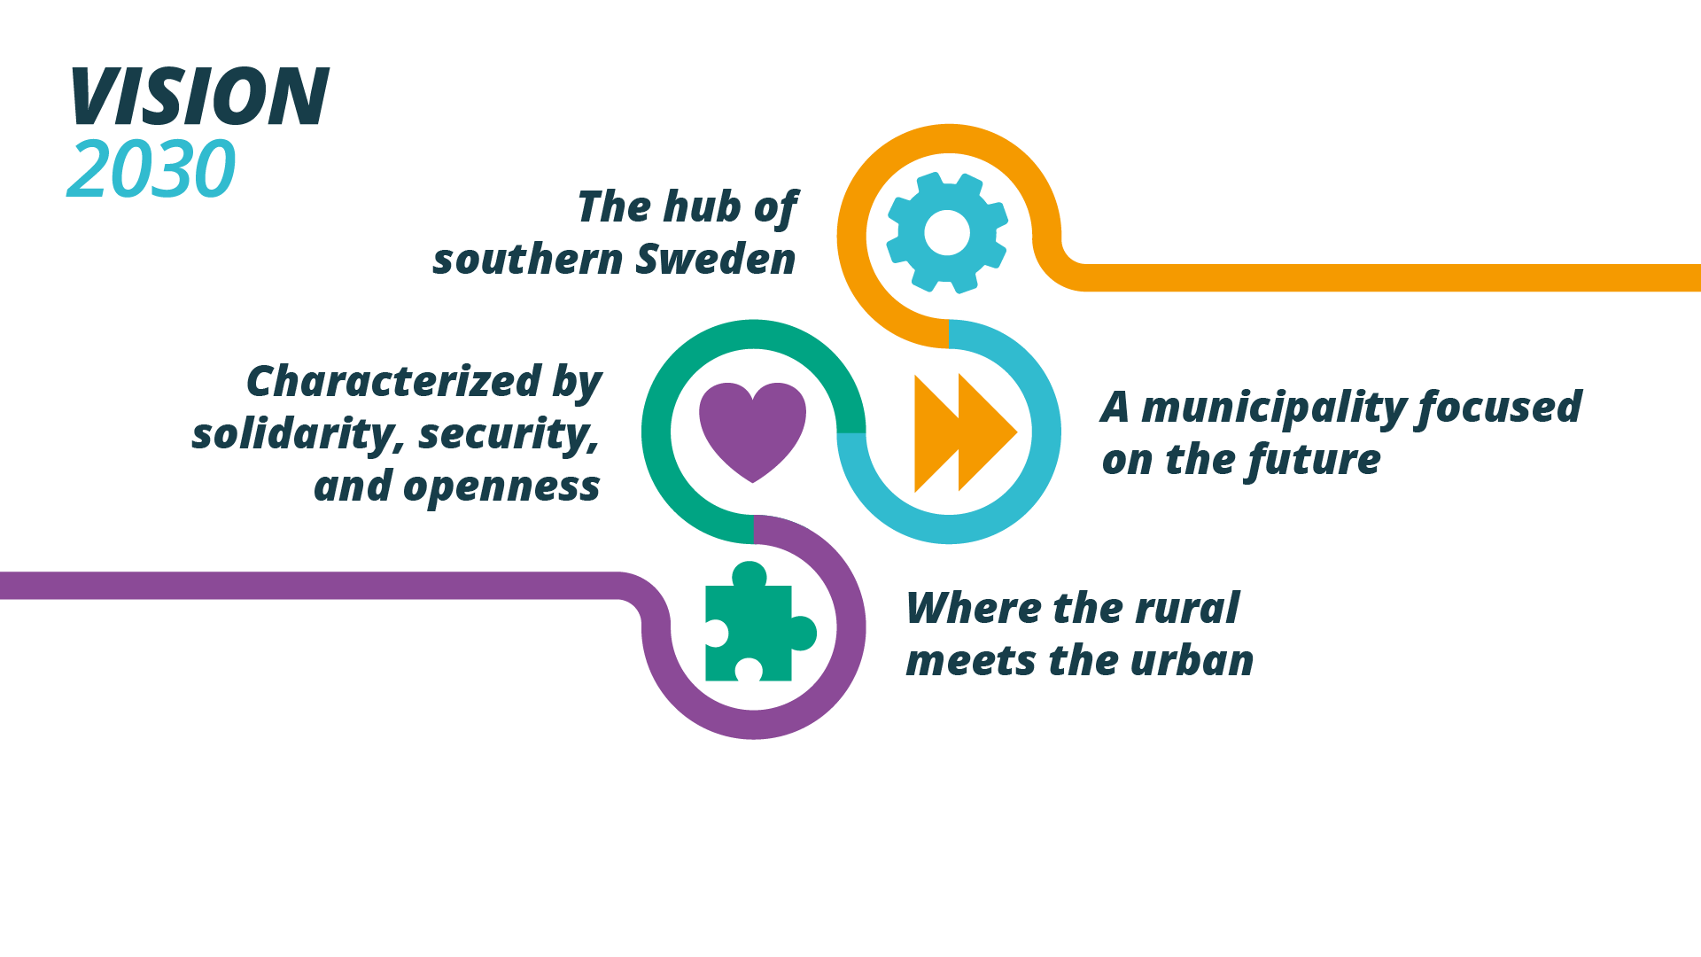
Vision 2030
Vision
Notes:
Our vision for the future - where we want to be by 2030
Our vision is that by 2030, Jönköping will be a large municipality with a small municipality's sense of community and security. A municipality for everyone, with open meeting places and a strong civil society. A municipality characterized by openness, participation, and accessibility. And one that is a safe and secure place regardless of where in life the municipality resident may find themselves.
The Vision can be summarized in the form of the four target areas within which we are aiming to position ourselves through to 2030:
• Jönköping 2030 will be the hub of southern Sweden
• Jönköping 2030 will be a municipality focused on the future
• Jönköping 2030 will be characterized by solidarity, security, and openness
• Jönköping 2030 will be a municipality where the rural meets the urban
All development in the Municipality of Jönköping will be founded on ecological, social and economic sustainability, contributing to Jönköping 2030 becoming a sustainable, climate-smart role model.
Jönköping 2030 will be the hub of southern Sweden
Jönköping 2030 will be a hub with first-rate communications with the world. It will be convenient and environmentally friendly to travel to and from the municipality, generating greater potential for living and working there. Its strategic location, in combination with a broad, expansive industrial base, will be the obvious choice for companies seeking to establish or develop their operations. Jönköping 2030 has profiled itself as a hub for culture, sport, and outdoor life.
Jönköping 2030 will be a municipality focused on the future
Jönköping 2030 will be an open and positive municipality with an international character where we have the determination and initiative to invest and think along new lines. By capitalizing on the knowledge and commitment of the people living in the area, conditions will be created for promoting a sustainable municipality where ideas are developed and where we are not afraid to act. Initiatives throughout the whole of the education chain, from preschool to university, will form the foundation for a municipality symbolized by knowledge, innovation, and creativity.
Jönköping will be characterized by solidarity, security, and openness
Jönköping 2030 will be a large municipality with the community spirit, safety and security of a small municipality – a place where the opportunity to interact freely and productively with others, coupled with a strong civil society, will help to create a municipality for everyone. The municipality will also be permeated by openness, integrity, involvement, and accessibility. Jönköping will be a safe and secure municipality, regardless of where you are in life.
Jönköping 2030 will be a municipality where the rural meets the urban
Jönköping 2030 has vibrant rural areas and thriving green industries. People throughout the whole of the Municipality of Jönköping are proud of their rural landscape and heritage and there will be excellent opportunities to create a place to live, to make a living, and to take advantage of a rich and rewarding range of leisure and recreation pursuits. Jönköping 2030 will be a strong regional centre with a wide variety of shops, cafés, restaurants, culture, entertainment, and other activities. Everyone will have somewhere to live and there will even greater potential for more people to choose the Municipality of Jönköping as their home.

Slide 11
In 2030, the Municipality of Jönköping will be an attractive, accessible and welcoming municipality to visit, live in, and work
– a place where people are happy and where they want to live and stay.
Notes:
It is a place where people want to reside and live their lives. As a municipality with a focus on the future we want to continue to develop together with those who live there. That is why we are being driven by the aims and ambitions set out in Vision 2030, making us one of the strongest city regions in the country. As the hub of southern Sweden, we are seeking to create a centre that is open yet secure. A place where people from town and country can meet, and with the potential to create and build for the future.

Slide 12
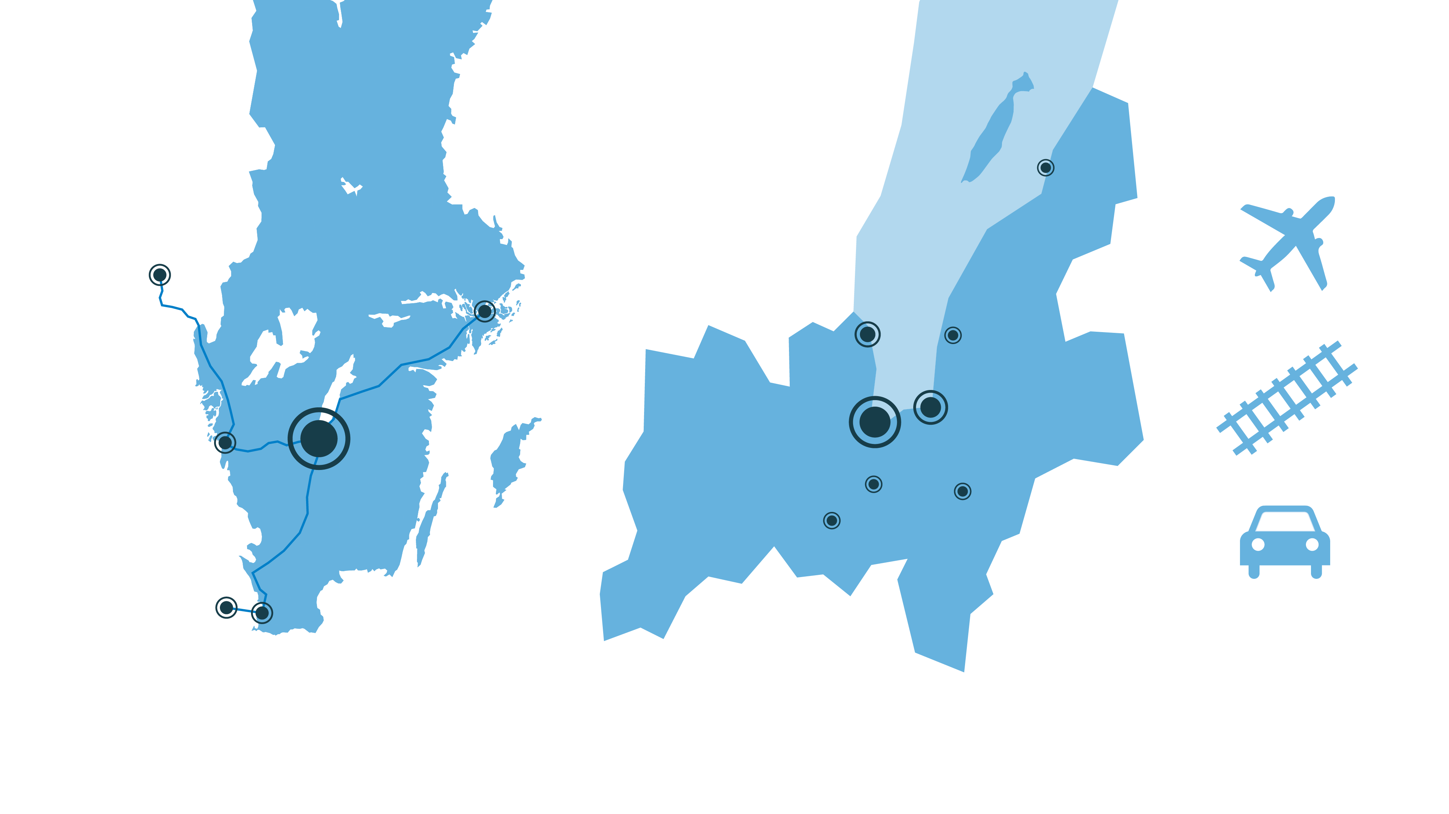
Hub of southern Sweden
Visingsö
Gränna
Oslo:
390 km
Stockholm:
320 km
Bankeryd
Kaxholmen
Huskvarna
Gothenburg:
150 km
Jönköping
Barnarp
Tenhult
Taberg
Copenhagen:
330 km
Malmö:
290 km
Notes:
We are a hub for southern Sweden, and we have excellent communications with the outside world – regardless of distance. The strategic location, in combination with our expanding industrial base, gives us the prerequisites for promoting innovation and maintaining a firm focus on the future. The location of our municipality in the heart of the Nordic region presents considerable communication potential with the rest of Sweden and the whole of Scandinavia.
Distances have been rounded off and are according to Google Maps (Shortest distance by car from the Town Hall in Jönköping to the centre of each town).
The largest towns and villages in the municipality of Jönköping are Jönköping, Huskvarna, Norrahammar, Bankeryd, Taberg, Tenhult, Odensjö-Barnarp and Gränna.
The towns and villages in the Municipality of Jönköping are: Jönköping, Huskvarna, Norrahammar, Bankeryd, Taberg, Tenhult, Odensjö-Barnarp, Gränna, Kaxholmen, Kortebo, Lekeryd, Bottnaryd, Skärstad, Ölmstad, Örserum, Hulukvarn-Ulvstorp-Västersjön-Hedenstorp, Tunnerstad, Öggestorp, Ryd, Bosgård-Rudu-Gisebo and Tovrida Udde.
The Municipality of Jönköping is made up of 12 municipal areas: Jönköping, Huskvarna, Gränna, Visingsö, Skärstad-Ölmstad, Lekeryd, Tenhult, Barnarp, Norrahammar-Hovslätt, Månsarp-Taberg, Bankeryd and Norra Mo.

Slide 13

Increasing population growth
The 9th
largest
municipality
in Sweden
Notes:
We are the 9th largest municipality in Sweden and the home of 147 654 people. The municipal population has grown considerably. Over the past five years, it has increased by an average of 1 300 inhabitants per annum.
Many of us, 96 585, live in Jönköping and Huskvarna.
The population also changes in line with the number of births. In total, 1 461 children were born in the Municipality of Jönköping in 2024, and we had a net birth rate (births minus deaths) of 327.

Slide 14
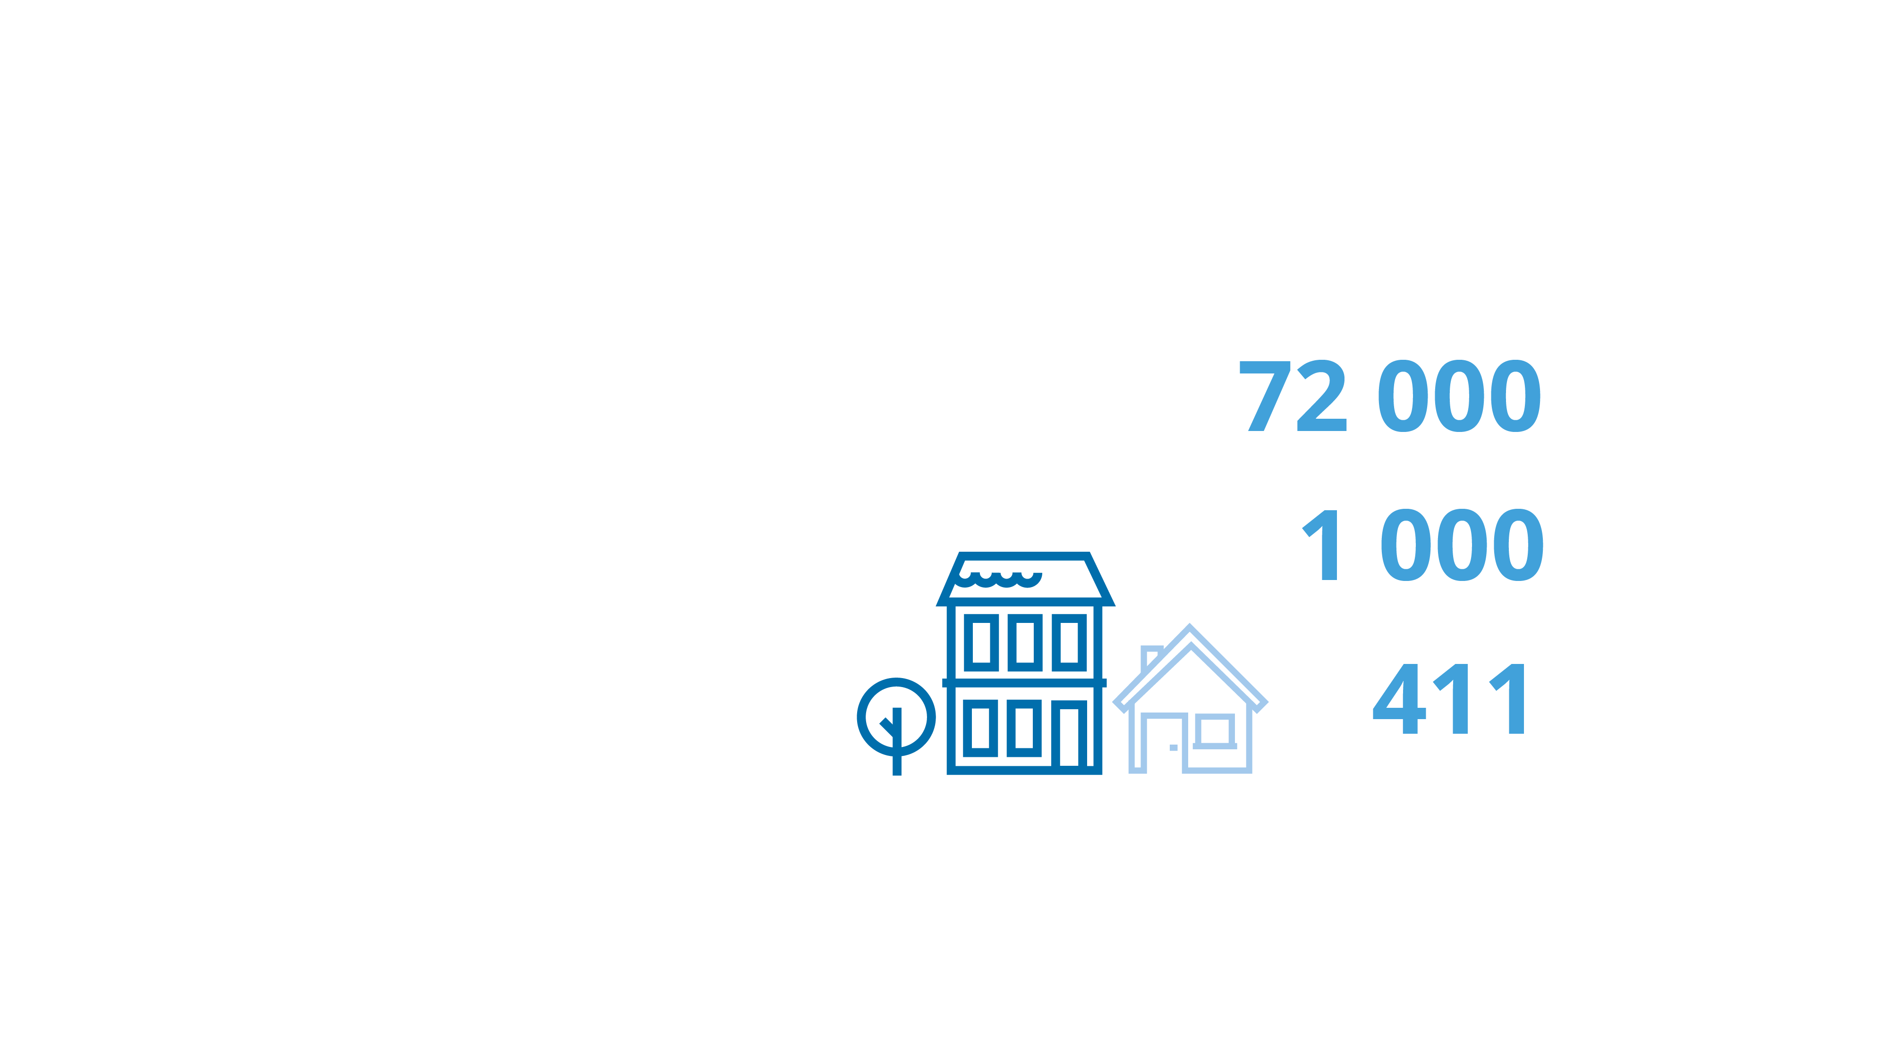
Building homes for the future
21 %
tenant-owned
45 %
rental
Homes in the municipality
34 %
privately owned
Homes will be constructed per year
Homes began being contructed in 2023
Notes:
There are around 72,000 residences in the municipality of Jönköping. Approximately 34 percent of these are privately owned, primarily consisting of multifamily residentials. About 21 percent are tenant-owned apartments (condominiums), and around 45 percent are rental apartments. For these two types of residences, the majority are apartments in Multifamily residential buildings.
The municipality has a goal of initiating the construction of 1,000 residences each year. In 2024, construction began on 411 residences in the municipality of Jönköping. Of the initiated residences, 61 percent were rental apartments, 28 percent were tenant-owned apartments, and 11 percent were privately owned. The number of initiated residences decreased compared to 2023 when 335 residences were initiated.
The number of ready-to-move-in residences during this year was 688 units. Of these, 90 percent were rental apartments, 2 percent were tenant-owned apartments, and 8 percent were privately owned.
As of January 1, 2025, construction was ongoing for 531 residences—61 percent rental apartments, 11 percent tenant-owned apartments, and the remaining 11 percent privately owned. A majority of the residences under construction at the turn of the year are expected to be completed during 2025.

Slide 15

Gender distribution and average age
40,8 years
Males: 39,9 years
Females: 41,7 years
Males:
74 305
Females:
73 349
Notes:
We are seeking to promote equality and create a municipality that is both inclusive and diverse. We are seeking to be a municipality with a community spirit and sense of security – where openness, interaction, and a strong civil society contribute to creating a municipality for everyone.
The average age in the municipality is 40.8 years – 39.9 years for men and 41.7 years for women.
The average age throughout Sweden is 42.2 years – 41.4 years for men and 43.0 years for women.

Slide 16


Education
Higher level of education:
47 %
Students at JU:
14,400
from 100 countries
Females: 53 %
Males: 41 %
Around 1,980 international
students each year.
Notes:
Higher education = post-high school education.
Progression into higher education in Jönköping: Average 47% – women 53%, men 41% (statistics from 2023).
Progression into higher education in Sweden: Average 45% – women 52%, men 39% (statistics from 2023).
14 400 students from 100 countries. Around 1 980 international students each year (14%), 7 880 full-year students.
(This figure includes exchange students who stay for one or two terms, international students who follow a programme extending over several years, and students on foundation courses).
The whole of the education chain is vital to our present and future well-being and we are investing strongly in education – all the way from preschool to university. We are seeking to create a municipality symbolised by knowledge, innovation, creativity, and inclusivity.
Jönköping University is organised as a foundation, and it awards degrees at bachelor’s, master’s, and PhD level. Jönköping University comprises four specialist schools. The four schools are the School of Education and Communication, the School of Health and Welfare, Jönköping International Business School, and the School of Engineering.

Slide 17
Politics and organization
Notes:
Politics and organization

Slide 18
Political organization
Election Committee/ Municipal Audit Department
Municipal Council
Municipal Executive Board with Advisory committees
Committees
Executive departments and Municipal companies
Notes:
The Municipality of Jönköping is a politically governed organization just like all the other municipalities in the country. Political decisions are reached by the Municipal Council, the Municipal Executive Board, and 12 committees.

Slide 19
Municipal Council and Municipal Executive Board
Municipal Council | 81 seats
Social Democrats (S) | 24 seats
Moderates (M) | 15 seats
Sweden Democrats (SD) | 12 seats
Christian Democrats (KD) | 12 seats
Centre Party (C) | 7 seats
Left Party (V) | 5 seats
Liberals (L) | 3 seats
Green Party (MP) | 3 seats
Municipal Executive Board | 15 seats
Social Democrats (S) Majority Coalition | 4 seats
Centre Party (C) Majority Coalition | 1 seat
Liberals (L) Majority Coalition | 1 seat
Green Party (MP) Support Party Majority | 1 seat
Left Party (V) Support Party Majority | 1 seat
Moderates (M) Opposition Coalition | 3 seats
Sweden Democrats (SD) Opposition Coalition | 2 seats
Christian Democrats (KD) Opposition Coalition | 2 seats
Notes:
Collaboration between the political parties in Jönköping municipality is important, negotiations between the parties are needed to form governance. The political majority consists of the Social Democrats, the Center Party, and the Liberals in collaboration with the Green Party and the Left Party.
The Municipal Council sets the political objectives for municipal operations. They decide, among other things, on the municipality's budget and finances and appoint members to municipal committees.
The Municipal Council has 81 members who are directly elected. The allocation of seats for each party is based on the election results.
The Municipal Executive Board leads and coordinates the work that are in line with the municipality's overarching objectives, guidelines. They prepare all matters for the Municipal Council. The main tasks include responsibility for the municipality's development and economy, comprehensive physical planning, land and housing supply, business and employment issues, procurement, information and tourism issues, and organizational matters.
The Municipal Executive Board has 15 members and 15 substitutes. Three councilors and two opposition councilors lead and coordinate the work of the Municipal Executive Board. Councilors: Ann-Marie Nilsson (C), Andreas Persson (S), and Mona Forsberg (S). Opposition councilors: Joakim Dahlström (M) and Andreas Sturesson (KD).

Slide 20
Committees under the Municipal
Executive Board
There are five committees under the Municipal Executive Board:
Management Committee
Human Resources Committee
Procurement Committee
Welfare Committee
Planning and Development Committee
Notes:
Ett utskott är en mindre del av en beslutande församling med uppgift att till exempel förbereda beslut.
Area of responsibility:
1. Management issues
2. Welfare issues
3. Urban development issues

Slide 21
Political committees
There are 12 committees:
Election Committee | Accessibility Support Committee
Custodian Committee | Eldercare Committee
Crisis Management Committee | Environmental Health and Protection Committee
Children and Schools Committee | Planning and Development Committee
Education and Labour Market Committee | Public Works Committee
Individual and Family Welfare Committee | Leisure and Cultural Services Committee
Notes:
De 12 politiska nämnderna ansvarar för olika delar av kommunens verksamhet och styr förvaltningarnas arbete.
Area of responsibility:
Management issues: Election Committee, Custodian Committee, Crisis Management Committee
Welfare issues: Children and Schools Committee, Education and Labour Market Committee, Individual and Family Welfare Committee, Accessibility Support Committee, Eldercare Committee
Urban development issues: Environmental Health and Protection Committee, Planning and Development Committee, Public Works Committee, Leisure and Cultural Services Committee

Slide 22
Eight Executive Departments
– with a total of 12,400 employees
Leisure and Culture Department
– 250 employees
Planning and Development Department
– 100 employees
Environmental Health and Protection Department – 50 employees
Central Administration Office
– 300 employees
Fire and Rescue Service
– 200 employees
Technical services department
– 900 employees
Social Services Department
– 5 300 employees
Education Department
– 5 350 employees
Notes:
We have eight departments with just over 12,400 permanent employees (around 13,600 if individuals on fixed-term contracts are included). They deal with day-to-day operations within all the areas covered by the municipal authority.
Our departments and their areas of responsibility are:
(The figures for the number of employees at the departments have been rounded off)
Leisure and Cultural Services Department – 250 employees
Recreation facilities, recreation activities, association support, activities for children and young people, and after-school centres. Responsible for the running of six heated swimming pools, as well as cultural activities open to the public, libraries, support for cultural associations, cultural environment conservation, public art etc. It also runs the Matchstick Museum and the Bird Museum.
Environmental Health and Protection Department – 50 employees
Monitors compliance with the Environmental Code and food legislation. Works with Agenda 2030 issues and is responsible for lakes and watercourses. Acts as a support body and advisory resource for the Municipal Executive Board and is responsible for liming and air quality measurement.
Fire and Rescue Service – 200 employees (about half of them are part-time employees)
Works with crime prevention, accident prevention, and crisis management and contingency planning. Accident prevention work includes fire safety, operational initiatives, fall prevention, suicide prevention, water safety, and road safety, as well as risk considerations in conjunction with physical planning. Responsible for the running of nine fire stations throughout the municipal area.
Social Services Department – 5,300 employees
Care of the elderly, individual and family welfare, health and medical care, and care of the functionally impaired. Around one in 10 inhabitants in the Municipality of Jönköping receive help from social services. Families and individuals receive advice, support, treatment, income support, and other forms of assistance under the Social Services Act. The Department also has overall responsibility for municipal eldercare services and welfare provision for the functionally impaired.
Planning and Development Department – 100 employees
Responsible for planning and construction matters, land survey matters, and traffic matters on behalf of the City Planning Committee. Develops and coordinates urban planning matters and the traffic infrastructure and runs development projects in the various urban centres within the municipal area. Also responsible for mapping and management of the municipal infrastructure.
Municipal Office – 300 employees
The central department in our municipality. Acts as the service body for the Municipal Council and the Municipal Executive Board. It is a strategic management and development resource for the whole of the municipality within finance, administration, development, HR, IT, communications, industry, procurement, and finance and companies.
Technical services department – 900 employees
Responsible for the functioning of the technical infrastructure, as well as buildings, land, nature areas, parks, streets, roads, water and sewage systems, and ferry traffic. It is also responsible for some of the waste management, ports, and parking, as well as planning of municipal housing and land provision.
Education Department – 5,350 employees
Covers operations from preschool to adult education and labour market matters. It is responsible for schools, family day care centres, preschools, high schools, special schools, the School of the Arts, adult education, and the UPPTECH science centre. It runs 95 preschools, 56 primary/secondary schools and 4 high schools within the municipal area.

Slide 23
Municipal companies
Municipality of Jönköping
Jönköpings Rådhus AB
Event companies
Housing companies
Energy and waste management companies
Property management companies
Other companies
Destination
Jönköping
Junehem
June Avfall
och Miljö
Högskolefastigheter
Jönköping
Airport
Elmia
Vätterhem
Jönköping Energi
Jönköpings kommuns Fastighetsutveckling
Södra Munksjön Utvecklings AB
Notes:
The municipality of Jönköping has established a group of wholly owned and majority-owned municipal companies with Jönköpings Rådhus AB as the parent company. There are ten companies in total, as well as a number of second-tier subsidiaries. The parent company, Jönköpings Rådhus AB, is responsible for the governance, supervision, and follow-up of all the companies in the group.
Destination Jönköping AB is charged with the task of marketing and promoting the development of the municipality of Jönköping as a tourist, event, and meeting point. Working in close collaboration with local hosts, associations, commercial enterprises, and industry, Destination Jönköping has developed a series of carefully formulated strategies to demonstrate that Jönköping has the scope and capability to be a world-class host. It has operational responsibility for Jönköpings Teater och Jönköpings Konserthus.
Elmia AB is one of the leading trade fair companies in the Nordic region, and each year it arranges trade fairs, conferences, congresses, and events for a whole range of business sectors. The aim of the company is to promote growth and development in the municipality of Jönköping and the surrounding areas.
Second-tier subsidiary: Näringslivets hus
Junehem AB is a housing company that owns and manages approximately 2 600 homes and about 20 000 m² of premises leased to businesses. Its mission is to provide housing in the suburbs and the countryside in Jönköping municipality.
Bostads AB Vätterhem is the municipality of Jönköping’s largest housing company. It owns, manages, and develops properties throughout the area. With 85,000 square metres of non-residential premises and over 8,900 apartments, it operates within the more urbanised areas in areas of Jönköping and Huskvarna in the municipality of Jönköping.
June Avfall & Miljö AB is jointly owned by the three municipalities Jönköping, Habo and Mullsjö. They conduct waste operations for each owner municipality. This means that they help approximately 163 000 municipal residents with waste collection, sludge emptying, and sorting yard operations. They handle 100 000 tonnes of waste from the municipality’s residents. A total of 1.5 million rubbish bins and 7 500 sludge bins are emptied per year. The company has about 100 employees.
Jönköping Energi AB is owned by the municipality of Jönköping and is part of a group made up of four companies. It provides 55,000 customers with lighting, power, heating, cooling, and urban utility networks. It is also responsible for generating power using local solar, wind, and water sources, as well cogenerated power. It offers a range of sustainable, innovative services, and is a major driving force for regional development.
- Second-tier subsidiary: Jönköping Energi Nät AB
- Second-tier subsidiary: Huskvarnaåns Kraft AB
- Second-tier subsidiary: NETSAM AB
Högskolefastigheter i Jönköping AB (HÖFAB) builds and manages premises for Jönköping University, and is responsible for 98,000 square metres of floor space and land area totalling 78,000 square metres. The company works closely with Jönköping University to create good, effective solutions for students and staff to meet changes in operating requirements. The company is partly owned (85.7%) by Jönköpings Rådhus AB. The remainder is owned by Jönköping University Foundation.
- Subsidiary: Campus Gränna AB
Jönköpings kommuns Fastighetsutveckling AB (JKPG Fast) satisfies the needs of the municipal authority, municipal inhabitants, and industry for land and commercial premises. It owns, manages, and develops properties. Its remit also includes contributing to the ongoing development of newly founded companies, as well as trade fair, event, conference, and cultural activities within the municipal area. The company owns a number of other companies, including Elmia, Hälsan 2 (Science Park House and Science Park Tower), the parking facilities Sesam, Per Brahe, Atollen, Smedjan, Biblioteket, Övertaget and Tändstickan and the subsidiary Jönköpings kommuns Fastighetsförvaltning AB, which has industrial premises at Industribyn Ljungarum.
- Second-tier subsidiary: Jönköpings kommuns Förvaltnings AB
Jönköping Airport AB operates and develops Jönköping Airport. Operations are divided into three main areas – regular traffic, charter traffic, and cargo traffic. In addition to commercial air traffic, Jönköping Airport has an important societal role to play as it is used regularly by planes operated by the firefighting, ambulance, and police services, as well military cargo planes, and planes used for organ transport. The company works actively with environmental and sustainability issues in a concerted effort to become a “Green Airport”.
Södra Munksjön Utvecklings AB (SMUAB) leads and drives the development of the new area of Södra Munksjön. This 300-hectare area will have 25,000 inhabitants, 11,500 workplaces, and large areas of land designated for commercial operations. The area will be an extension of Jönköping city centre and will become an attractive location for both residents and visitors with excellent communications and proximity to countryside, lakes, and rivers.
The Science Park in Jönköping is partially owned by the Municipality of Jönköping. It serves as a shared meeting place for creativity, innovation, development, and experiences. A hub for entrepreneurship, students, businesses, and individuals seeking inspiration and growth together.
Jönköping City ABJ önköping City AB is also owned by the municipality. It is a city development company that enhances, activates, and creates a pleasant environment in the city center of Jönköping for all businesses, residents, and visitors.

Slide 24
Municipal tax revenue is allocated as follows:
100 SEK in municipal tax (one SEK is equivalent to 1 % of the total budget)
Notes:
Our main source of income is the municipal tax that residents pay every month on their salaries. Together with government grants and tax equalization, it finances 80% of our ongoing activities, such as schools, libraries, museums, elderly care, roads, sports halls, parks, ports, etc. Everything that we, who live and have activities in Jönköping municipality, benefit from together.
In 2024, we had a total of SEK 12,9 billion in revenue from our operations, taxes and government subsidies, and equalization. The tax rate for housing in Jönköping municipality in the income year 2024 is 33,658%.
Municipal tax: 21,64% + County council tax: 11,76% + Funeral fee: 0,258% = 33,658%
The remaining activities at 3 Kronor include labor market measures, business promotion measures, political activities, tourism activities, port operations, and more.

Slide 25
Labour market and industry
Notes:
Labour market and industry

Slide 26

Wide range of sectors
Largest sectors:
Care and welfare | Retailing | Manufacturing and recycling | Corporate services | Education | Transport and storage
Large companies:
Husqvarna AB | IKEA | Kabe Group AB | SAAB | Vy Buss| Fläkt Group AB |
Elgiganten | PostNord | Arla Foods
15 690
companies in
the Municipality
of Jönköping
Public authorities and regional bodies:
Board of Agriculture | National Courts Administration | Forest Agency | County Administrative Board | Jönköping University | Region Jönköping County|
Municipality of Jönköping
Notes:
We have a total of 15,690 registered companies and organisations in the municipality. We have a large range of sectors with leading companies in logistics and transport, manufacturing, retailing, IT, and communications. We have an exhibition and trade fair centre at Elmia. Many people are self-employed. Our strength lies in having a mixture of companies. There are both highly innovative IT companies that have been recently started, as well as old-established industrial enterprises with a long and illustrious history. The development of the technology of the future takes place at companies old and new.
Largest employers in 2025, number of employees*:
Municipality of Jönköping – 15,075
Region Jönköping County – 8,775
Husqvarna AB – 2,225
IKEA – 1,275
Board of Agriculture – 875
Arla Foods – 675
SAAB Group – 825
Kooperativet OLJA – 625
Elgiganten – 575
KABE AB – 575
Swedish courts – 575
FläktGroup Sweden AB – 475
PostNord – 575
The police authority – 425
Jönköping University – 375
Samhall AB – 325
Vy Buss AB – 375
Source: SCB:s Business register
*) Employees are those who earn SEK 1,000 / month or more.

Slide 27
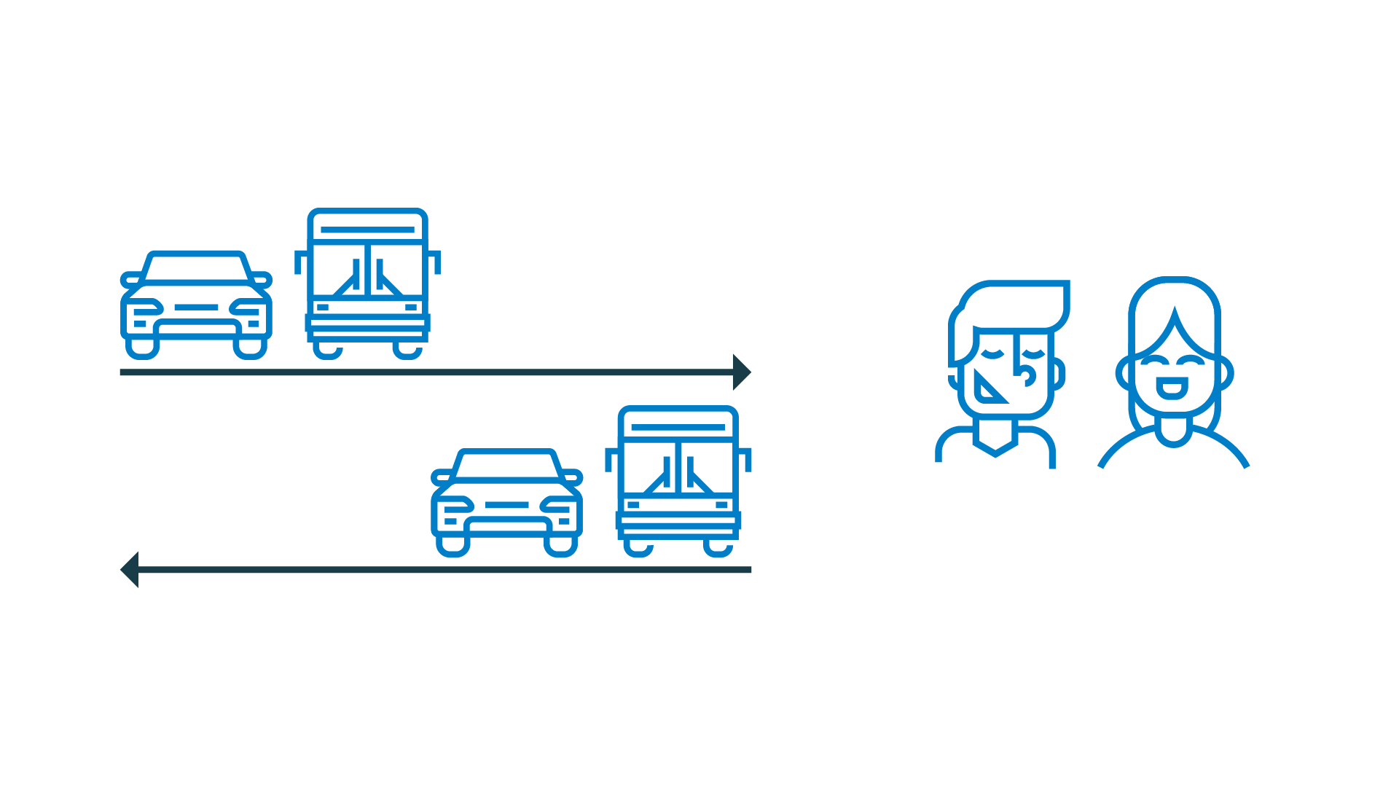
Large labour market region
Inward commuting:
16 500 people
Outward commuting:
9 931 people
82 275 people employed
Net commuting: +6 561 people
Notes:
We are the eighth largest labour market region in Sweden. Many people choose to commute here for work.
Inward commuting = people who live in another municipality but work in the municipality of Jönköping.
Outward commuting = people who live in the municipality of Jönköping but work in another municipality.
82,275 people employed = individuals aged 16 or older and who are in paid employment for at least one hour per week at a workplace within the municipal borders.

Slide 28

Low unemployment rate
Municipality
of Jönköping:
5,6%
Sweden:
6,8%
Notes:
The rate of unemployment in the municipality is lower than the national average. We strive to create conditions for our inhabitants that offer them flexibility when choosing where and how to live.
The unemployment figures represent the proportion of the workforce aged 16-65 years in the Municipality of Jönköping who are unemployed.
Total: 5,6 %
Women: 5,3 %
Men: 5,9 %
Proportion of the workforce in Sweden aged 16-65 years who are unemployed:
Total: 6,8 %
Women: 6,6 %
Men: 6,9 %

Slide 29

Typical Jönköping
Notes:
Before we continue, we can take a little break and have a look at some of the more unusual facts about Jönköping and the region.
Jönköping is sometimes known as the Jerusalem of Småland although it is not because we have lots of churches. The origin of the nickname goes back more than 160 years. In 1858, the rule that only ordained priests were allowed to hold prayer meetings was rescinded. In the wake of this momentous change, large numbers of free church members flocked to attend prayer meetings in the Jönköping area.
Pizza and kebab sauce are a winning concept, particularly in Jönköping. Our kebab sauce is so popular it even has its own Facebook page.
The classic peppermint rock candy Polkagris comes from Gränna. Dating back to 1858, we can thank confectioner Amalia Eriksson, who was the first to make the classic polkagris. There are seven polkagris producers in Gränna that are open all year round. The world polkagris-making championship is held in Gränna each year.
Dating back to the 17th century, the Husqvarna brand is very much a part of Swedish industrial history. Husqvarna built its first motorcycle back in 1903, and it is one of the oldest motorcycle brands in the world.
Jönköping is associated strongly with its dialect. Typical of many of those who live in Jönköping is the absence of the letter R in the pronunciation of various words.
There are only three matchstick museums in the world. Jönköping has one of them. The Matchstick Museum is located in what is known as the Matchstick District, and even today buildings still remain from the heyday of the matchstick industry. In 1844, brothers Johan and Carl Lundström started producing matches in Jönköping. In 1853, they switched from the highly dangerous phosphorus matches and began producing safety matches based on a patent held by researcher Gustaf Erik Pasch. The Lundström brothers also designed the match box that we know today, with its narrow side and a strip for lighting the match.

Slide 30
We are a municipality where our sights are set firmly on the future
Notes:
Our municipality is growing expansive, the digital infrastructure is developing, people and companies want to move here.

Slide 31

Steady growth
It is estimated that by 2030
the municipality will have 153,000 inhabitants.
Notes:
The steady growth means that we are planning for the day when the municipality will have a population of 200,000.
The following are just some examples of how we are equipping ourselves to meet the future:
We have a many building projects in progress.
Several new preschools are being built and temporary measures are being taken by renting premises to ease the pressure in areas where more buildings are needed.
We are developing the Södra Munksjön area.
A long-term water and sewage plan with a vision, strategy and measures focusing on 2030.
Planning for a new high-speed rail link.
A new comprehensive plan is being developed to enable sustainable development, allowing the municipality to grow to 200,000 residents.
These are just a few of our plans designed to create an attractive municipal area for everyone.

Slide 32
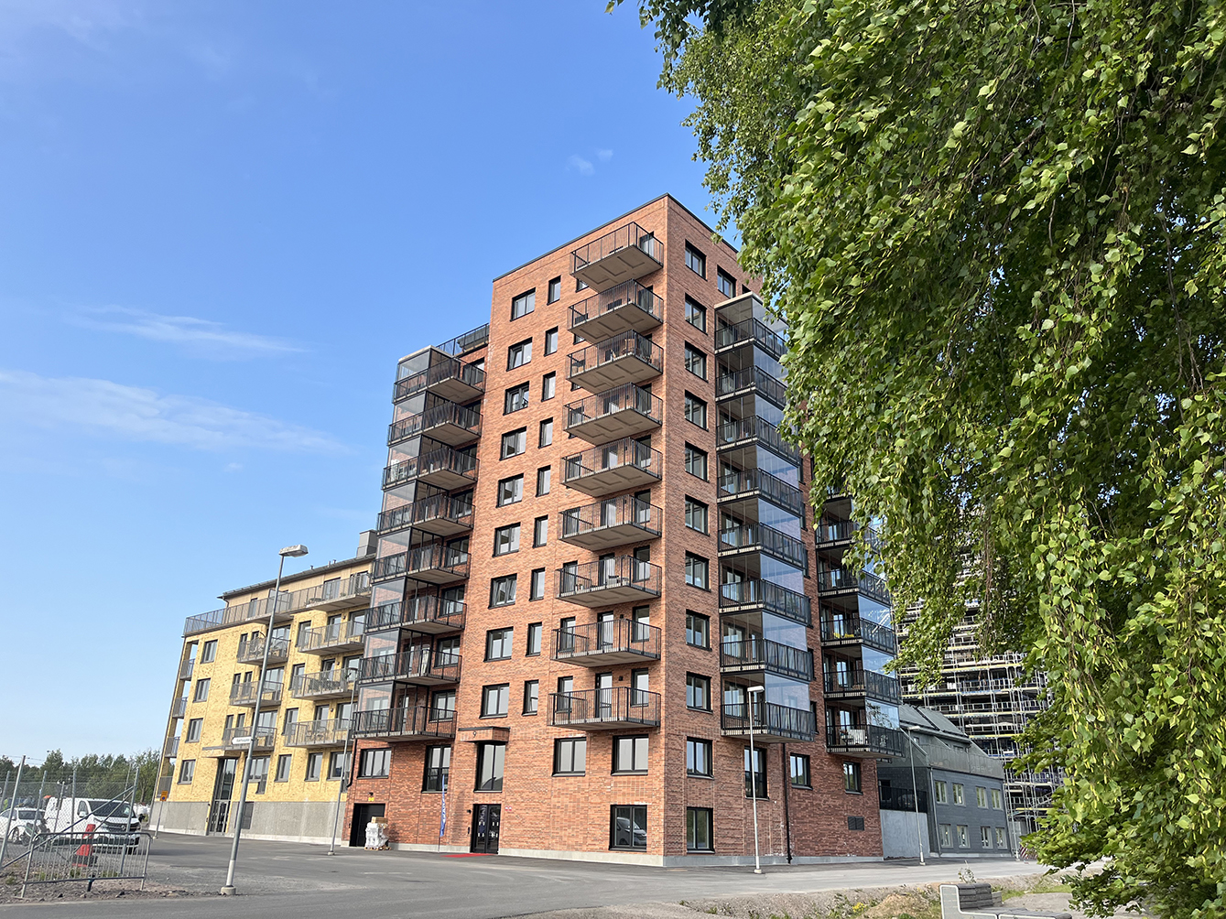
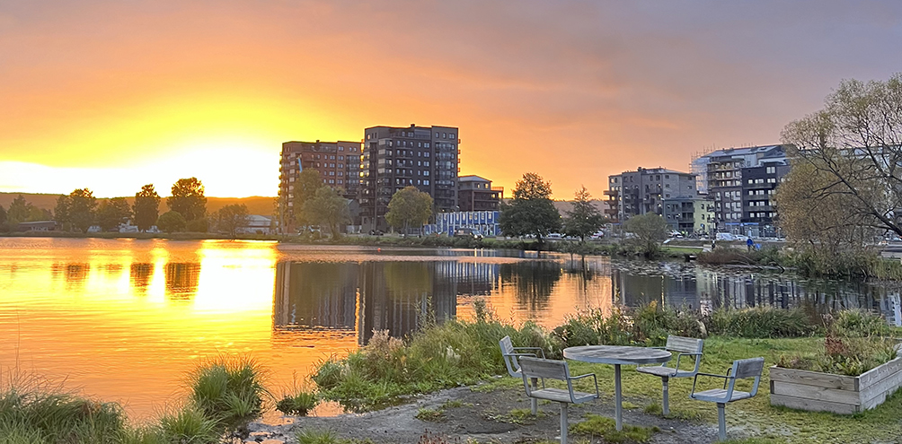
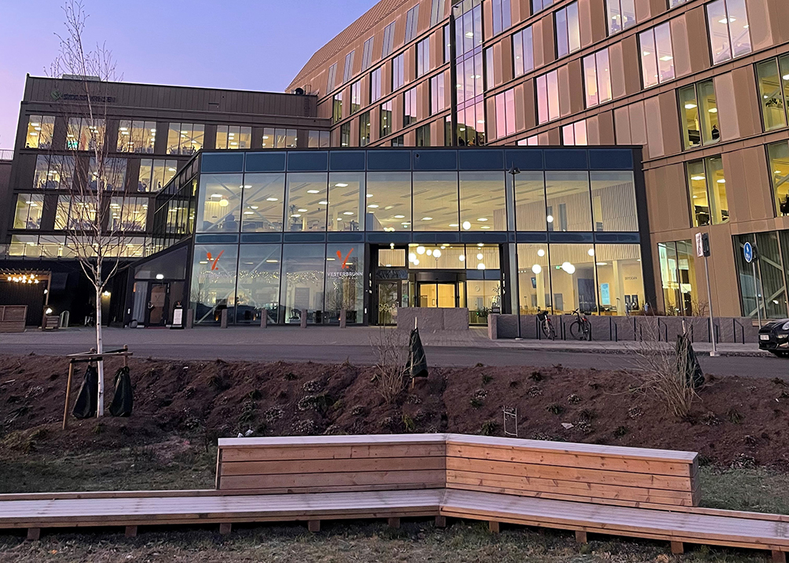
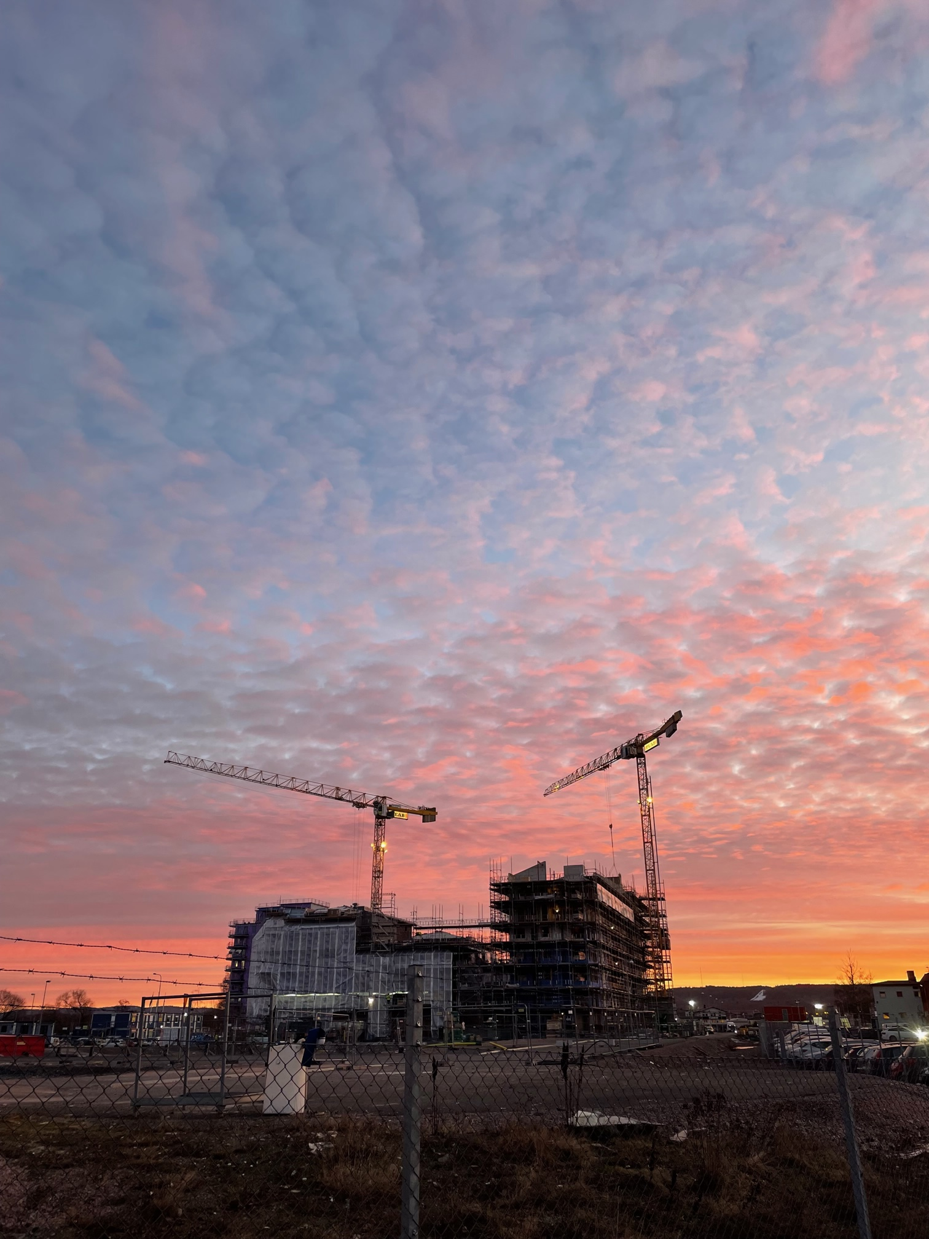
Södra Munksjön
– a new part of Jönköping
Notes:
The municipal-owned company Södra Munksjön Utvecklings AB has the remit of leading and running the development of the Södra Munksjön area. Södra Munksjön will become a place designed and designated for the people of the Municipality of Jönköping. With more districts and more homes in proximity to nature and water, we will create a new hub, brimming with life, people, and first-rate communications. In Urban Development Vision 2.0, we highlighted the Södra Munksjön area as the city’s new district. Following completion, the area will provide space for 25,000 residents, 11,500 workplaces, and 450,000 square metres of commercial premises.

Slide 33
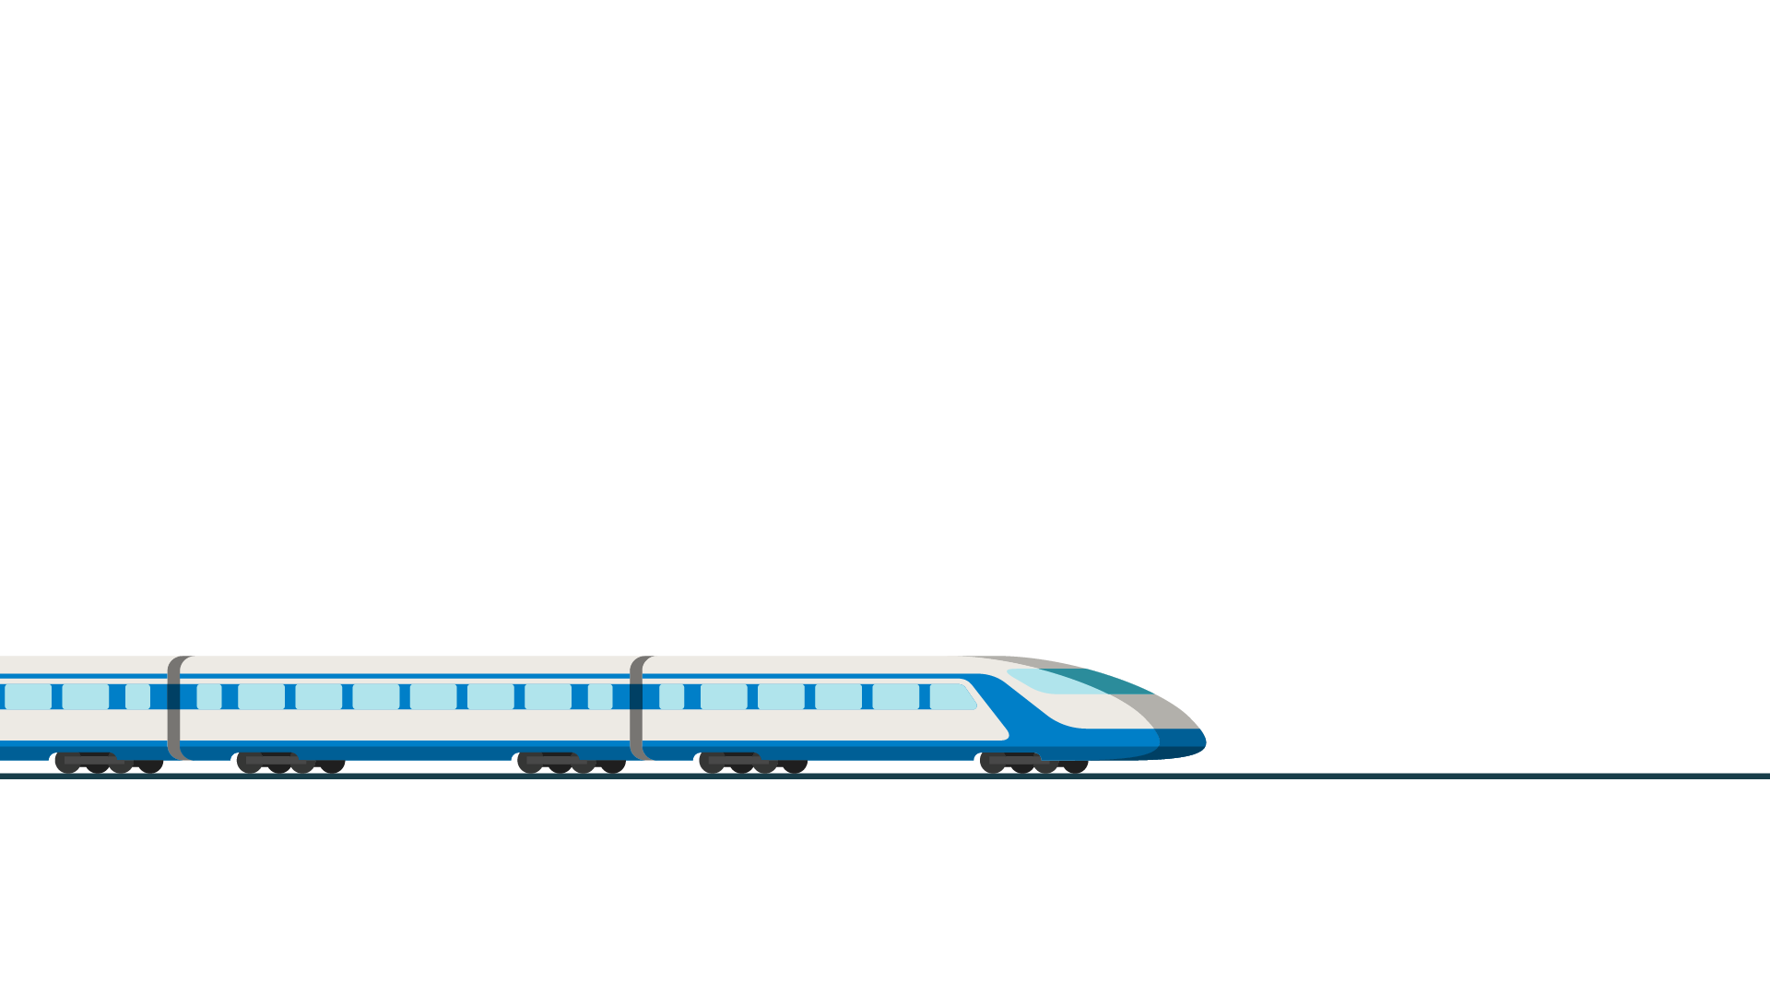
Hub of the future
Travelling times
Stockholm 1 h 30 min
Gothenburg 50 min
Malmö 1 h 30 min
Borås 40 min
Linköping 1 h
New railway route is planned to pass through Jönköping.
Notes:
The new trunk line is part of a wide-ranging infrastructure project which will create new opportunities for the people of the region. Thanks to the enhanced commuting potential that will be created, a new and expanded labour market will open up. We will grow and become an attractive municipal area, both to live in and to visit. It will also benefit commerce and industry.
The Södra Munksjön area will be the site of the station for the planned high-speed rail link. The station will be in an entirely new location, offering further opportunities for us to become a hub for the whole of southern Sweden.
Approximate travelling times by train at present:
Stockholm – 3h 30 min
Gothenburg – 2h
Malmö – 2h 50 min
Borås – 1h 10 min by bus (rail is not the best option)
Linköping – 1h 40 min

Slide 34

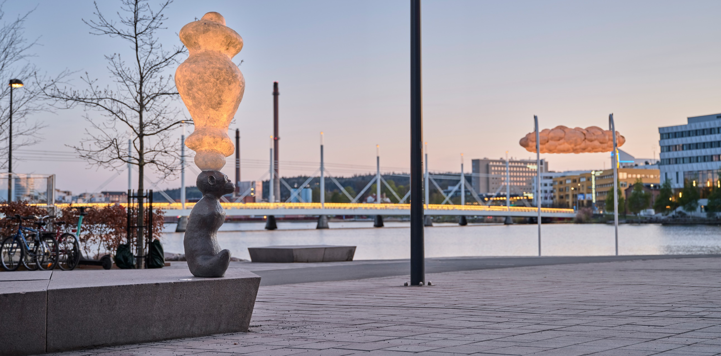

Urban meets rural
Notes:
Wherever you choose to live in our municipal area you will be close to the countryside and water. It is at the confluence of three lakes in what is a truly vibrant urban centre – and where city life and the countryside interact on a daily basis. There are arenas and meeting points for industry, associations, culture, and recreation. Both urban development and nature are multifaceted, and there is something for everyone.
A wide range of restaurants and cafés.
An extensive choice of concerts, performances, sports events, and forest walks.
Vätterstranden. A several-kilometre long sandy beach with large grassy areas in the very heart of Jönköping. Vätterstranden extends from Rosenlund in the east and a couple of kilometres west towards the city centre.
Äppeldalen in Kaxholmen with its fantastic views across Lake Vättern, often nicknamed the Tuscany of Småland.

Slide 35
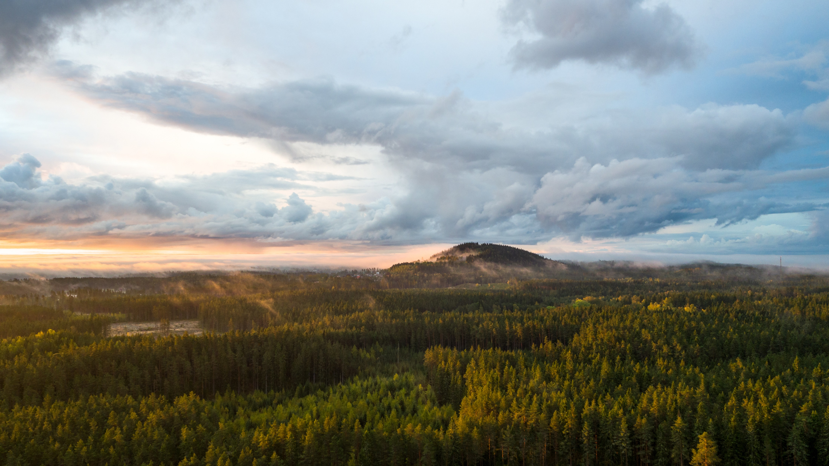
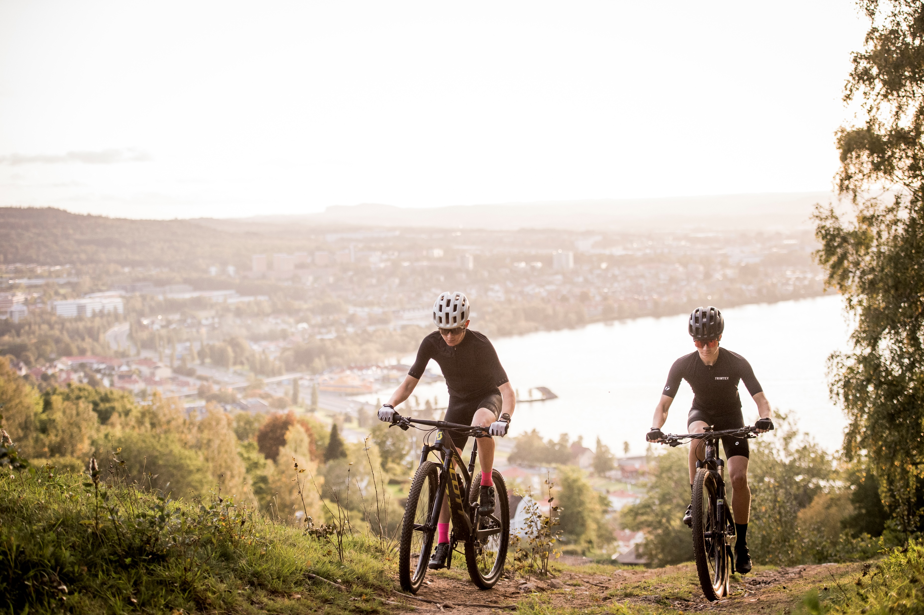
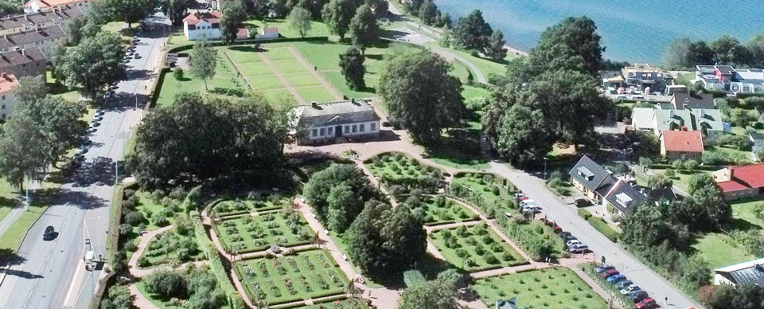
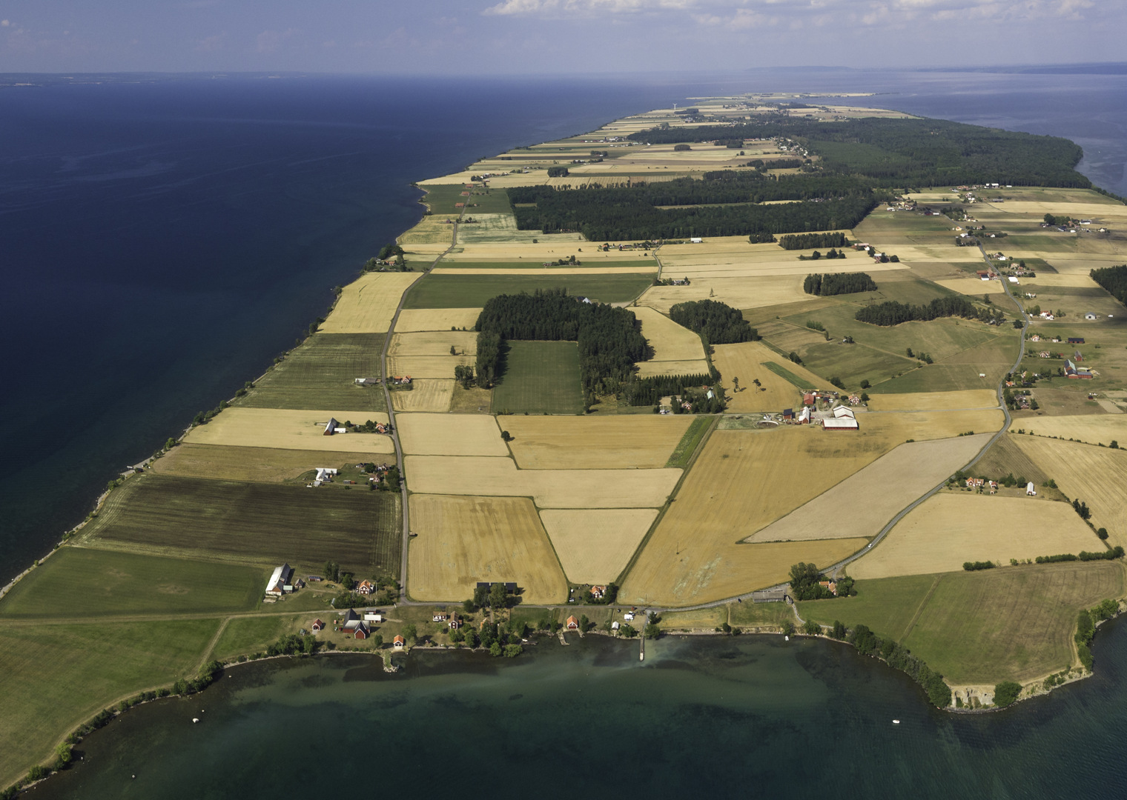
2025-04-24
Notes:
More examples:
Magnificent natural experiences that include the ‘shiny black mountain’ at Taberg with the opportunity to see a number of rare minerals and protected bat species.
The Rosenlund Manor and its Rose Garden, boasting 550 different varieties of roses, are a true treasure nestled on the slopes overlooking Lake Vättern in central Jönköping.
Gränna, with its quaint streets and leafy gardens, exudes picturesque charm.
Visingsö, Lake Vättern's largest island, offers a wealth of experiences and history to explore.
Brahehus, the ruins of the country residence of Count Per Brahe the Younger, located beside the motorway at Vätterbranten, is one of the most visited historical sites in Sweden.
The Östra Vätterbranterna biosphere area. In summer 2012 it became a UNESCO-designated biosphere area. It offers tantalising forest meadows, trees in every shape and form, ravines, and ancient forest settings.

Slide 36
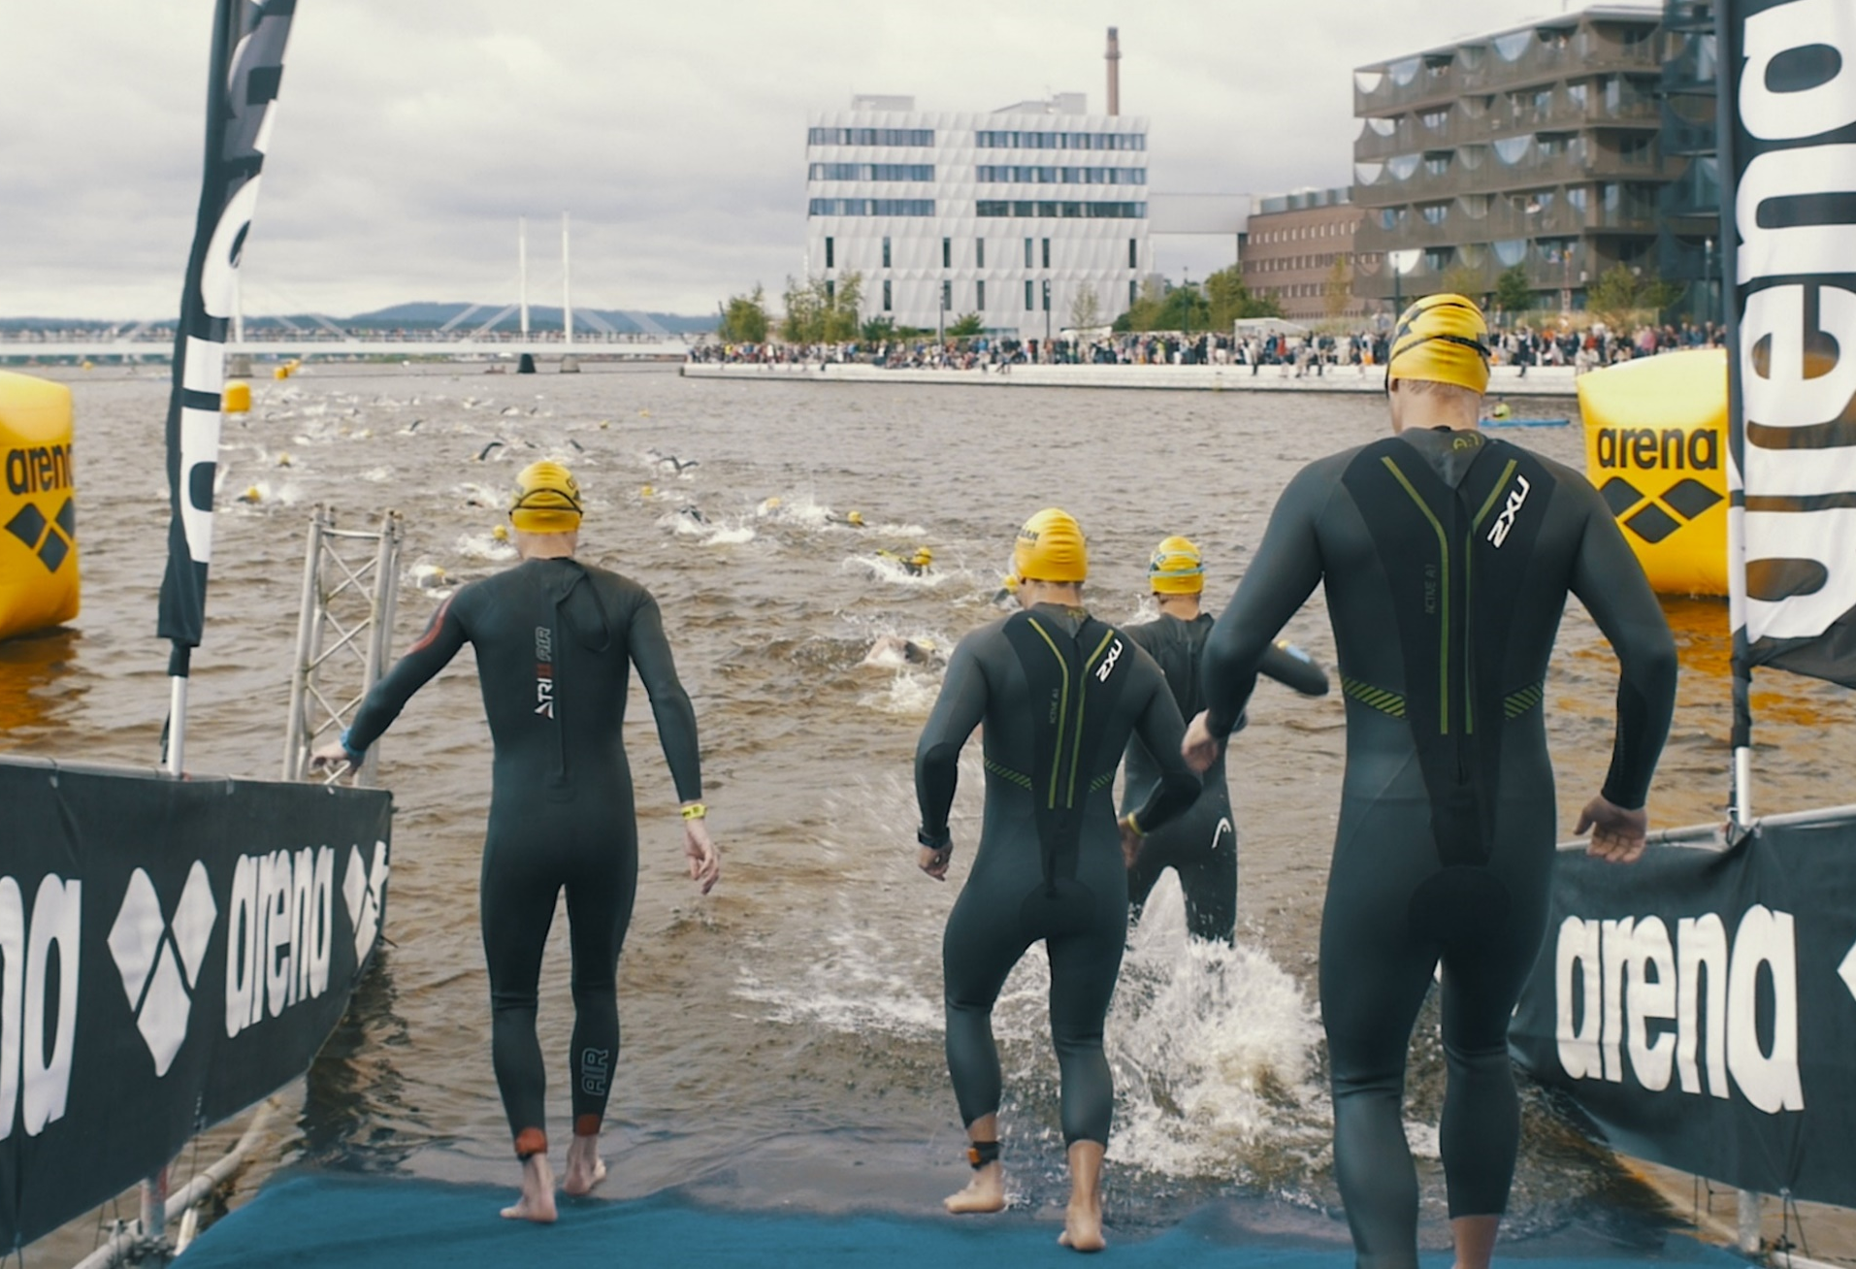
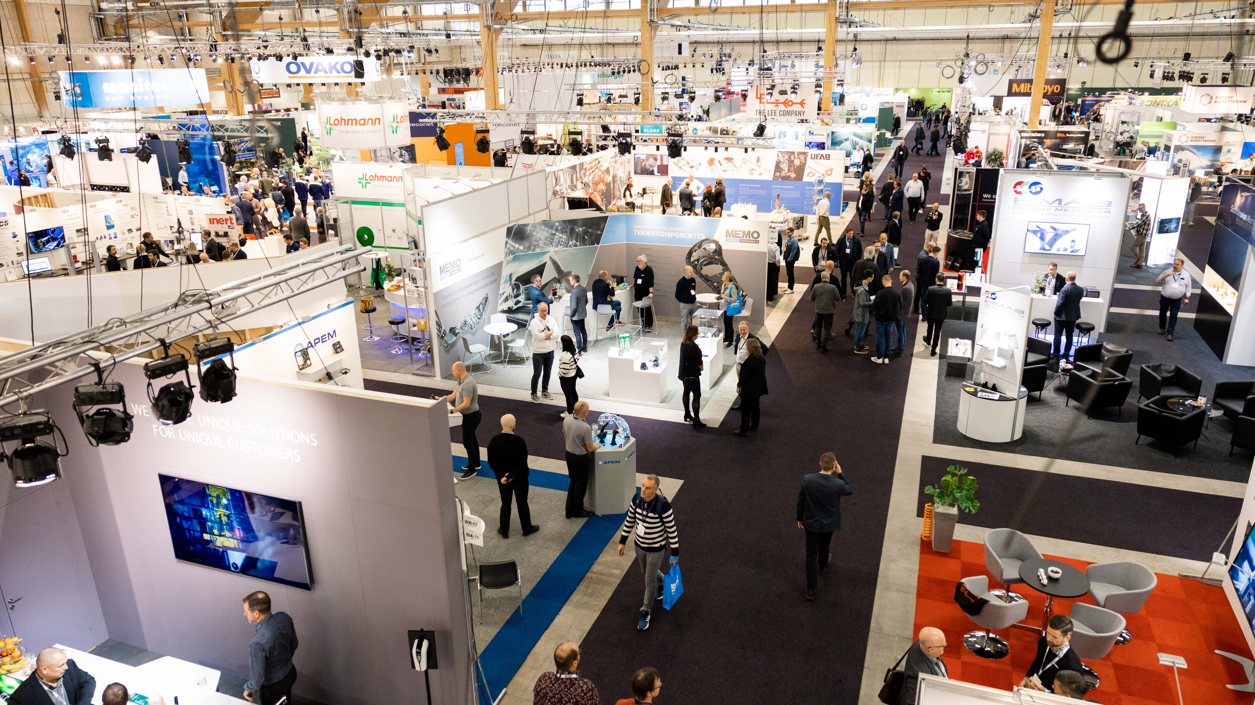
International and national events
Notes:
We are pleased to share our municipal area with others, and provide space and opportunity for activities, events and public festivities.
Ironman attracts more than 2,000 participants from all over the world.
We are also often the venue for fairs - and can be proud to be the organizer of Elmia Subcontractor, which is one of Sweden's major industrial fairs. The fair also celebrates its 50th anniversary in 2025.

Slide 37
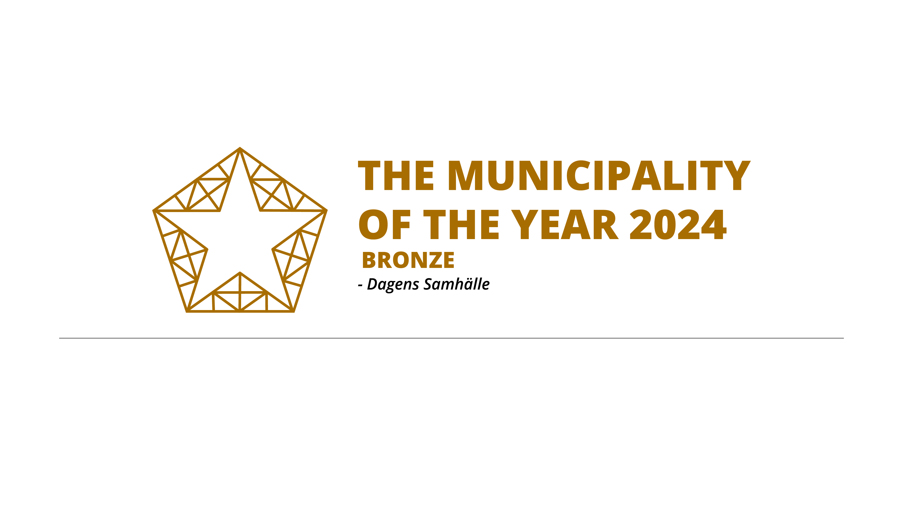
Prizes and awards
Access City Award 2021
European Commission
Top ranking in the citizen survey 2023
Statistics Sweden
Best employer among Sweden’s municipalities 2019
Universum
Notes:
We have a lot to be proud of in Jönköping Municipality and it's not just us who think so. We have received several awards over the years:
Third place in the Super Municipality of the Year 2024. The Super Municipality of the Year is awarded in three categories: Metropolitan Municipalities, Cities and Urban Municipalities and Small Towns and Rural Municipalities. Jönköping Municipality has subscribed to a final place in the Cities and Urban Municipalities category since 2019. In 2021 it was a bronze placement, in 2022 gold, in 2023 silver and in 2024 bronze. A municipality with a strong labor market, good population growth, sustainable communities and good schools and culture and leisure. These are all parameters that made Jönköping win the Super Municipality of the Year 2022 in the Cities and Urban Municipalities category. The award is presented by Dagens Samhälle.
The most association-friendly municipality of the year: The motivation highlights the long-term work that has been done to create good conditions for associations and civil society – through collaboration, sustainable development and innovative investments in sports, culture and civil society. Jönköping Municipality has for a long time created good conditions for association and civil society life through collaboration, sustainable development and innovative investments. With over 400 associations and civil society organisations, and a high proportion of association-run sports facilities, there are unique opportunities for associations to grow and develop. The municipality's support in the form of grants, practical help and clear strategies ensures a continued strong association community. The prize is awarded by: Sveriges Föreningar
Sustainability Performance of the Year 2023 Jönköping Municipality is awarded Sustainability Performance of the Year 2023 for saving thousands of kilowatt hours during a challenging year of electricity shortages and high electricity prices. An award that many employees have contributed to through energy-efficient initiatives in large and small ways. The best sustainability performance of the year is awarded by the magazine Miljö & Utveckling. A total of 63 sustainability achievements were nominated for the award, which applies to initiatives in 2023 but was awarded in 2024.
In Statistics Sweden’s citizen survey 2023, Jönköping Municipality’s results are above the national average in the majority of the survey’s questions. Overall, the results show that the municipal residents think that Jönköping municipality is a very good municipality to live in and that the municipality manages its operations well and that you can recommend others to move here.
Our schools stand out as an area that consistently receives high ratings, from preschool to adult education. According to the education track, most respondents to the survey also believe that there are good opportunities to stay in the municipality while pursuing post-secondary studies. They also feel that there are good prospects for finding employment within a reasonable distance from where they live. In the realm of cultural life and meeting places, we also receive ratings above the national average. This includes questions about the availability of cafes and restaurants, playgrounds and parks, and the municipality's efforts to promote local cultural activities. There are also areas where we can improve, such as transparency and influence in local politics. Just like in the 2021 survey, there is only one question where the municipality's results are clearly below the national average: What do you think about the ease of transporting yourself by car?
In 2019, Jönköping was named the city centre that has the best economic prerequisites according to a city survey run by the consulting company WSP. The survey covered 67 Swedish medium-sized and large city centres.

Slide 38
Thank you for listening!
Notes:
Thank you for listening!

